Slide 1


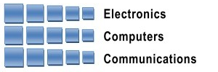
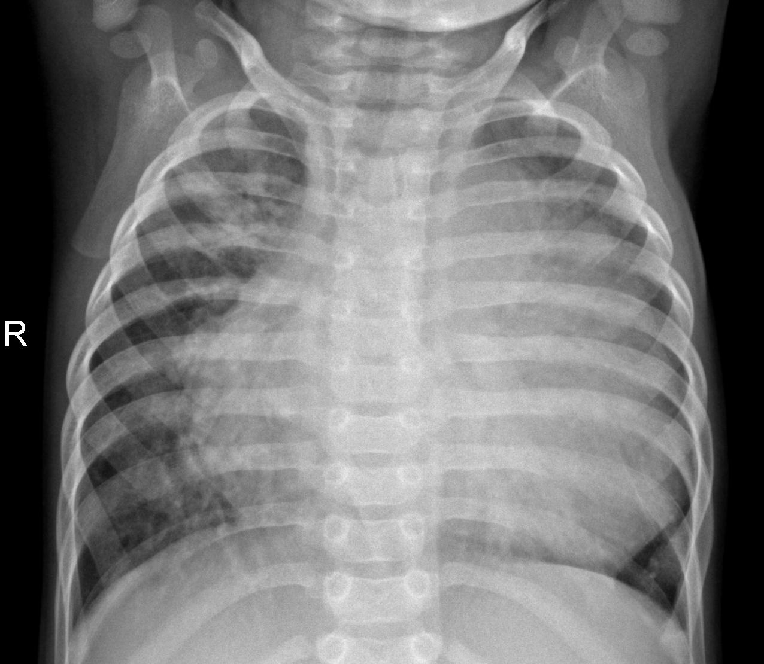

Andrew and Erna Viterbi
Faculty of Electrical Engineering
Signal and Image Processing Lab
Pneumonia Detection from Chest X-Rays with Robustness to Deformations
Andy Rodan and Or Glassman, Supervised by Yair Moshe
Introduction
Deformable Convolutional Networks
Robustness
Introduction of the problem
DCN theory
Proposed solution
Reuslts?
Pneumonia affects millions of people and is one of the top 10 causes of death in the USA
Pneumonia can be seen in chest X-Ray as one or more areas of increased opacity in the lung
Quick diagnosis is key to effective treatment of Pneumonia
Requires examination by medical expert to diagnose Pneumonia from chest X-Ray
CNN-based diagnosis algorithms steadily improve, still much room for improvement
TO BE DECIDED (not sure what to put here)
Results
Chest X-Ray of Pneumonia infected lungs
Goals
Address image deformations by implementing deformable network
Improve diagnosis of Pneumonia from chest X-Rays
Challenges
Chosen Solution
Data labeling often ambiguous
Implementing DCN model into known CNN architectures
Write on DCN integration into
RESNET
ALEXNET
Show scheme
Data
Conclusions
Successful estimation of proximity
Robust results with different object shape, size or geometry
Computationally efficient algorithm
In collaboration with
July 2019

